Slide 1

Microsoft Excel 2013
Dr. Wameedh. T.M. Al-Tameemi

Slide 2
Excel 2013 Formulas
Basic Formulas
Microsoft Excel is an electronic spreadsheet that automates manual calculations involved in accounting and bookkeeping. After you have typed the basic text and number entries in a spreadsheet cell, Excel can perform the math calculations for you. You will learn how to create formulas and functions to perform calculations in a spreadsheet.
Example formulas are: =D15+D18+D21 : =B4-B12 : =A10/B15 : =(B16+C16)*1.07
Do not use any spaces in formulas. Also, when creating formulas you may choose to either type the cell address or use the mouse to select the cell address.

Slide 3
Excel 2013 Formulas
Create Formula
You can create any type of math calculation on your own using the following mathematical operators:
The numeric keypad on the right side of the keyboard provides most of these operators. Excel follows the mathematical order of hierarchy where operators are processed in the order: negation, exponentiation, multiplication/division, and then addition/subtraction. Use parentheses to clarify the order of calculation in a formula.

Slide 4
Excel 2013 Formulas
Basic steps for creating a formula:
1. Click in the empty cell which will contain the formula.
2. Type an equal sign (=).
3. Type the cell address or click the cell that contains the first number.
4. Type the math operator (+ - / * ^).
5. Type the cell address or click the cell that contains the second number.
6. Continue in this manner until the formula is complete.
7. Use parenthesis for clarification.
8. Press the Enter key.

Slide 5
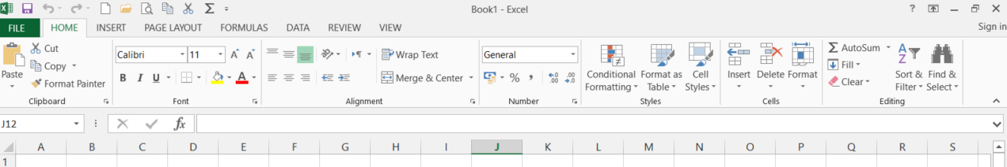

Excel 2013 Formulas
AutoSum
Adding is the most common math operation performed in Excel. The Home ribbon includes an AutoSum button for adding. This button provides a shortcut to typing formulas.
Home→ Editing→ Auto sum
Formulas→ Function library → Auto sum

Slide 6
Excel 2013 Formulas
Basic Steps for using AutoSum:
1. Move to the empty cell that will contain the formula.
2. Click on the AutoSum button.
3. Proofread the formula that Excel provides, make any necessary changes.
4. Press the Enter key or click the check mark on the formula bar.
Note: You can copy formulas that refer to empty cells. After you type numbers in the empty cells, the formulas will be updated.
Note: Formula results are updated automatically in Excel. As you change any values that are referred to in a formula, the formula will reflect these changes.

Slide 7
Excel 2013 Formulas
Formula Functions
Functions provide an automated method for creating formulas in the following categories: financial, date and time, math and trigonometry, statistical, lookup and reference, database, text, logical and information. Excel contains more than 200 functions. For example, specific functions are available to calculate a sum, an average, a loan payment, logarithms and random numbers. Functions can be typed, if you know the syntax, or can be inserted by clicking on the Function button located left of the formula bar.
All functions are formatted in a similar manner, for example: = function name (parameters). The parameters vary depending upon the function. Functions and cell addresses may be typed in upper case or lower case.

Slide 8
Excel 2013 Formulas
Sum
Adding is the most common function performed in Excel. The SUM function adds values. Specify values, individual cell addresses and/or range addresses in the numbers variables.
syntax =SUM(number1,number2,...)
examples =SUM(A10:A25)
=SUM(B15:C20)
=SUM(D45,D60:D70,D80:D85)

Slide 9
Excel 2013 Formulas
Insert Function
This selection demonstrates how to use the Insert Function menu to creation a formula. Click on the Insert Function button or from the AutoSum drop-down arrow and select More Functions to display a list of over 200 functions available in Excel. The Insert Function dialog box displays the function categories from the drop-down menu list. The function names will appear in the function name box below.

Slide 10
Excel 2013 Formulas
Average
An average sums all values and divides by the total number of values. Specify values, individual cell addresses and/or range addresses in the numbers variables.
syntax =AVERAGE(number1,number2,...)
examples =AVERAGE(15,255,45)
=AVERAGE(B2:B18)
=AVERAGE(B15,B33,B52)
=AVERAGE(C22:C24,C30:C33)

Slide 11
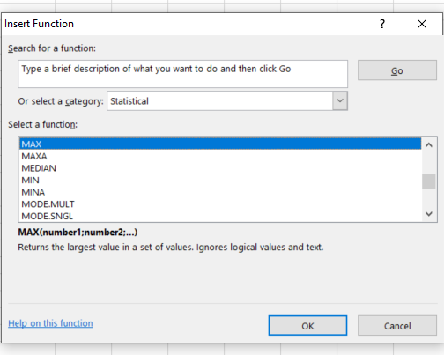
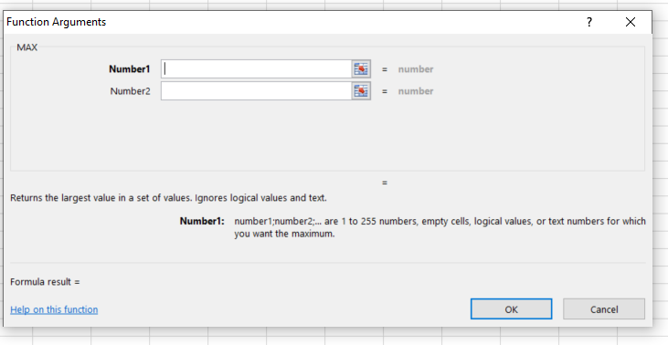
Excel 2013 Formulas
Maximum (MAX)
Maximum indicates the largest value in the designated list of numbers.
syntax =MAX(number1,number2,...)
examples =MAX(A15:A35)
=MAX(D10:D200,D225:D325)
Minimum (MIN)
Minimum indicates the smallest value in the designated list of numbers.
syntax =MIN(number1,number2,...)
examples =MIN(A15:A35)
=MIN(D10:D200,D225:D325)

Slide 12
Excel 2013 Next
Next lecture: Formulas-II
Thank you very much

